Slide 1


Uncovering the Electro-mechano-physiological Rules of Life​​
By Abygale Cochrane and Erica Hengartner
Advisor: Xin Tang, Ph.D. (xin.tang@ufl.edu)
Integrative Mechanobiology & Biophysics Laboratory (IMBL)
Department of Mechanical & Aerospace Engineering
J. Crayton Pruitt Family Department of Biomedical Engineering

Slide 2
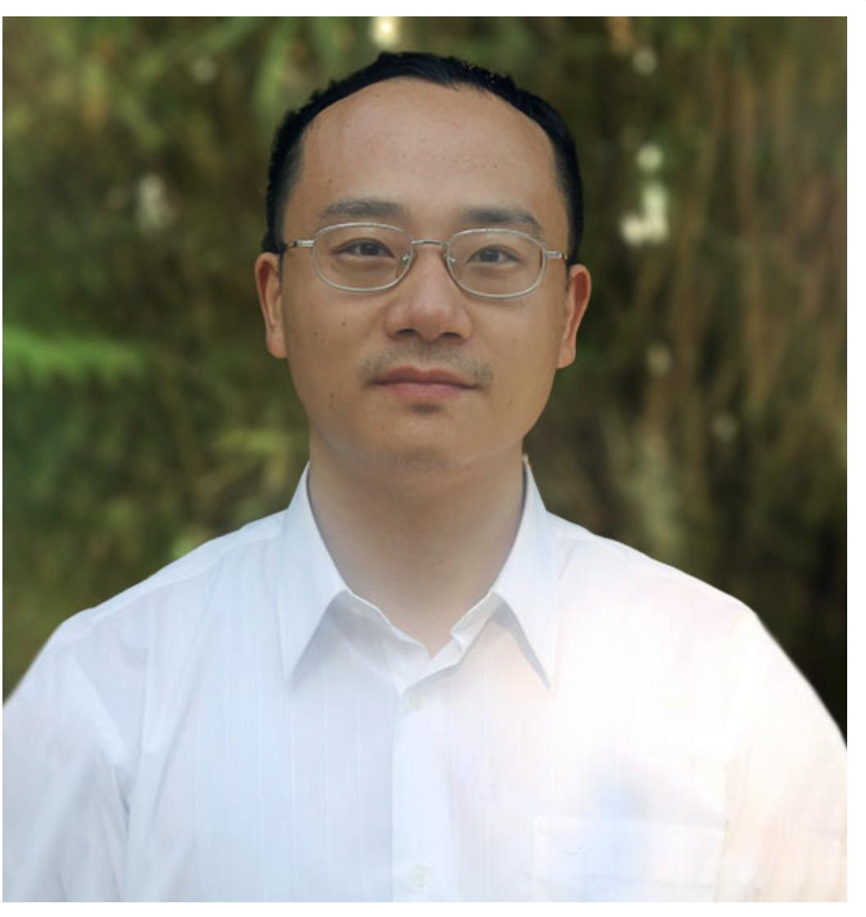
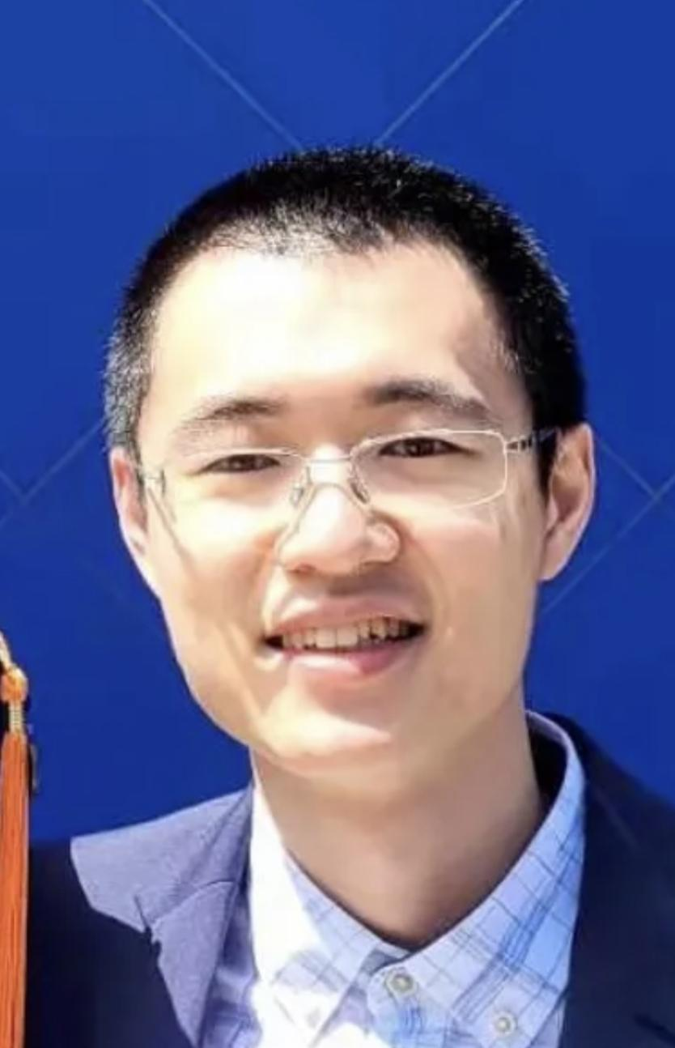
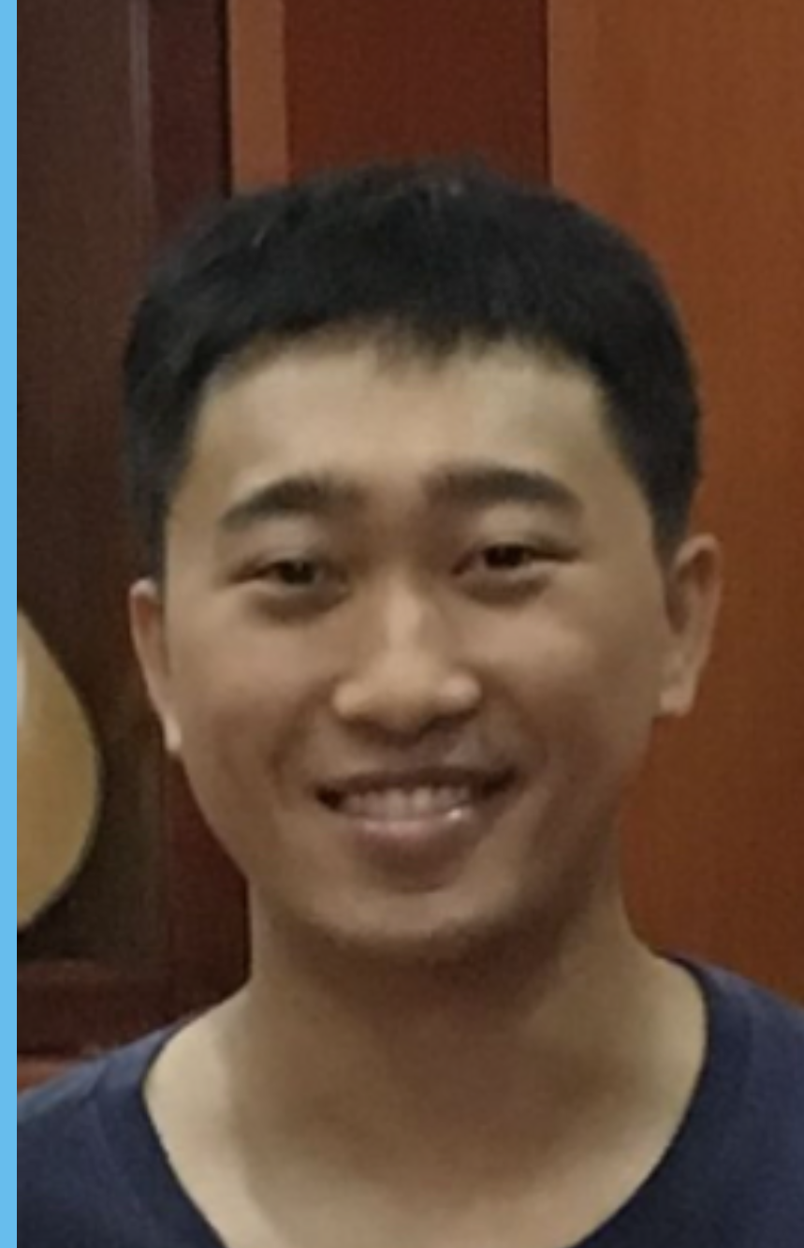
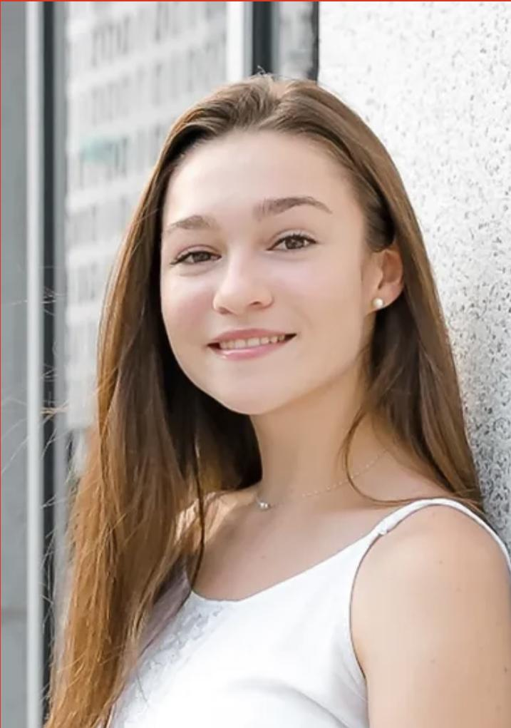
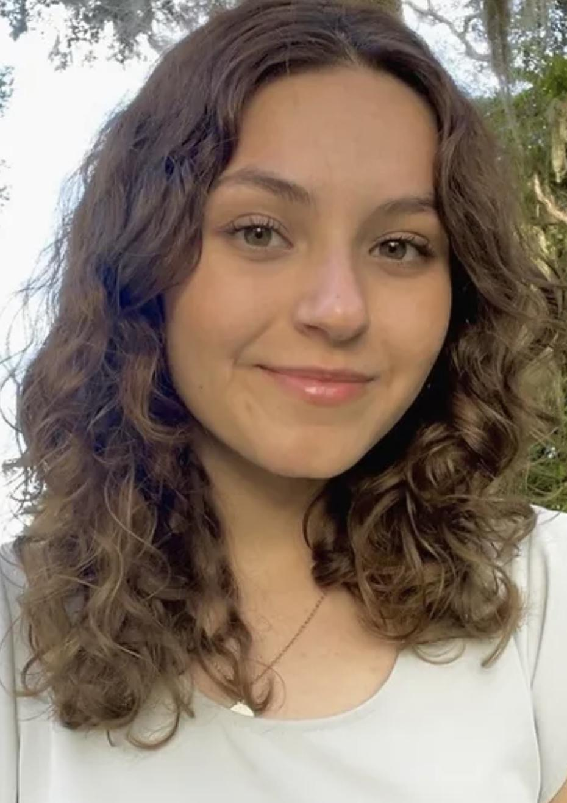
Our Team
Dr. Xin Tang
(xin.tang@ufl.edu)
Chenyu Liang
Miao Huang
Abygale Cochrane
Erica Hengartner

Slide 3
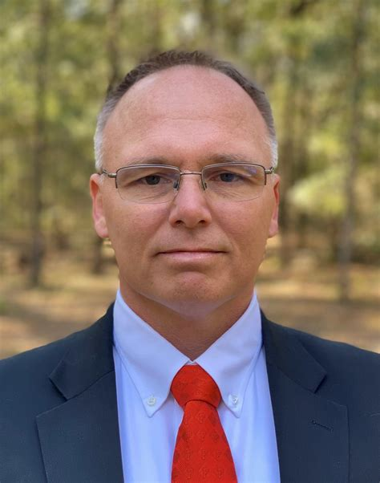
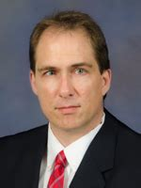
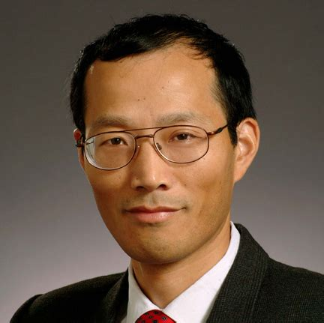
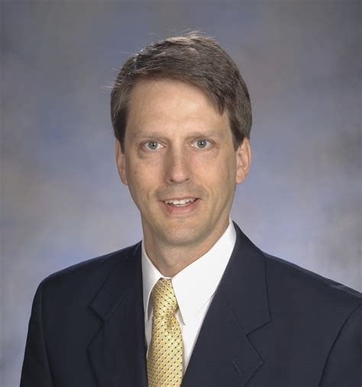
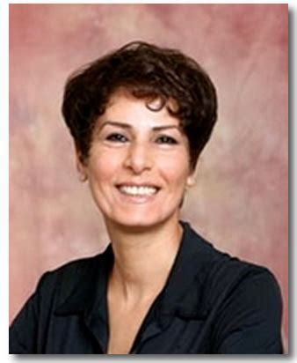
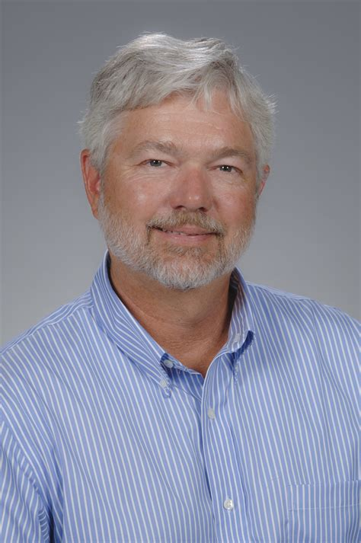
Acknowledgements
Dr. Warren Dixon
Dr. Mark Sheplak
Dr. Habibeh Khoshbouei
Dr. Hugh Fan
Dr. Jack Judy
Dr. Robert Caudle
We sincerely appreciate the generous helps from and intellectual discussions with: Dr. Jonathan Licht (UFHCC), Dr. Rolf Renne (UFHCC), Dr. John Wingard (UFHCC), Dr. Thomas George (UFHCC), Dr. Paul Okunieff (UFHCC), Dr. Mark Sheplak (MAE & ECE), Dr. Warren Dixon (MAE), Dr. Scott Banks (MAE), Dr. Hugh Fan (MAE), Dr. Ghatu Subhash (MAE), Dr. Hitomi Greenslet (MAE), Dr. Malisa Sarntinoranont (MAE), Dr. Chelsey Simmons (MAE), Dr. Ting Dong (MAE), Dr. Yong Huang (MAE), Dr. Matthew Traum (MAE), Dr. David Hahn (Univ. of Arizona), Dr. Yenisel Cruz Almedida (Pain Science), Dr. Roger Fillingim (Clinical Pain), Dr. Yuqing Li (Neuroscience), Dr. Andrew Maurer (Neuroscience), Dr. Blanka Sharma (BME), Dr. John Neubert (Orthodontics), Dr. Ji-Hyun Lee (Biostatistics), and Dr. Jessie L-S Au (Optimum Therapeutics). ​

Slide 4
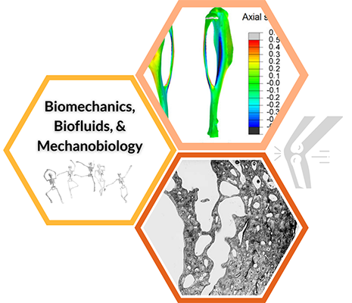
Overview
We are investigating biological systems that control functions via both electrical cell membrane potentials and mechanical forces that modulate:
Proliferation
Communication
Computation
Migration
What is the All-Optical Electro-Mechano-Physiology Interrogation System?
A wide-area optical interrogation system that can both visualize and control electro-mechano-physiological signals.
Notes:
Increasing evidence suggests that many biological systems, including but not limited to brain and heart, can modulate their electrical membrane potential and apply mechanical forces simultaneously to regulate key functions, such as proliferation, communication, computation, and migration.
Limited technology currently to better understand spatial-temporal dynamics of these signals

Slide 5
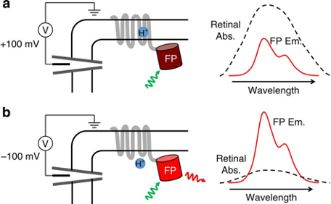
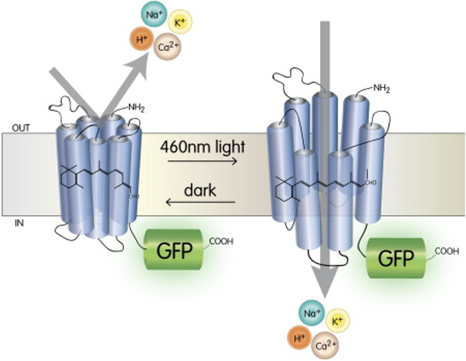
Genetically Engineered Proteins
QuasArX is a red-light excitable archaerhodopsin that monitors voltage activity through changes in fluorescence intensity.
CheRiff is an ion channel that is blue-light sensitive. It stimulates action potentials by causing depolarizations.
GCaMP5G is a blue light excitable calcium indicator.

Slide 6
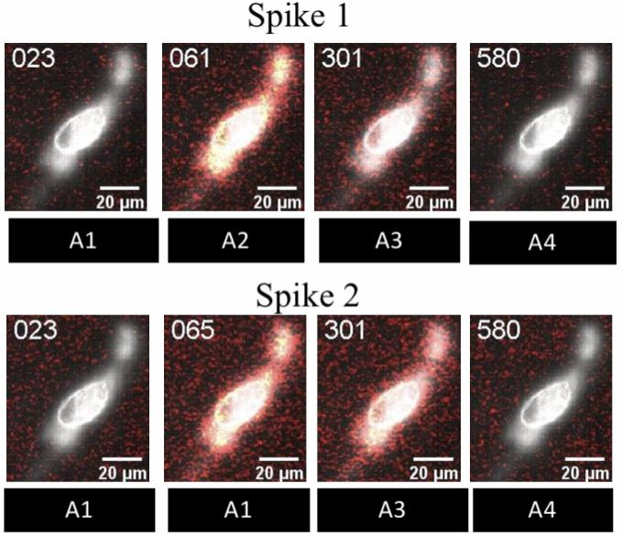
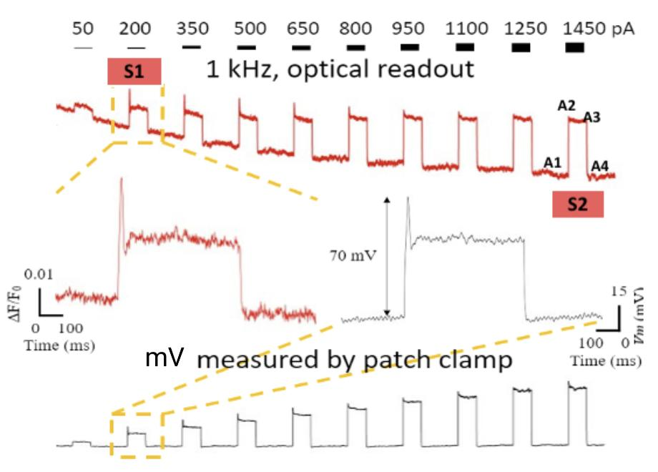
Neuronal Results (in vitro, ex vivo, and in vivo)
Coexpression of QuasArX and CheRiff allows for simultaneous stimulation and readout

Slide 7
Full length video of neuron firing
S2 AP.avi

Slide 8
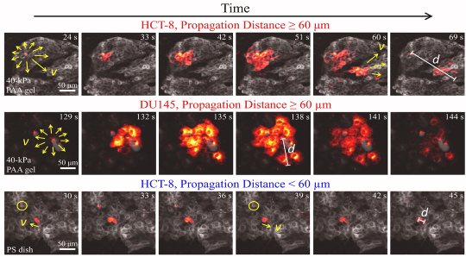
Cancer Cell Results
Readout of spontaneous Ca+ signals in HCT-8 Cells
Liang C, et al. Biomaterials, 2022
Xin Y, et al. Oncogene (Nature), 2023

Slide 9
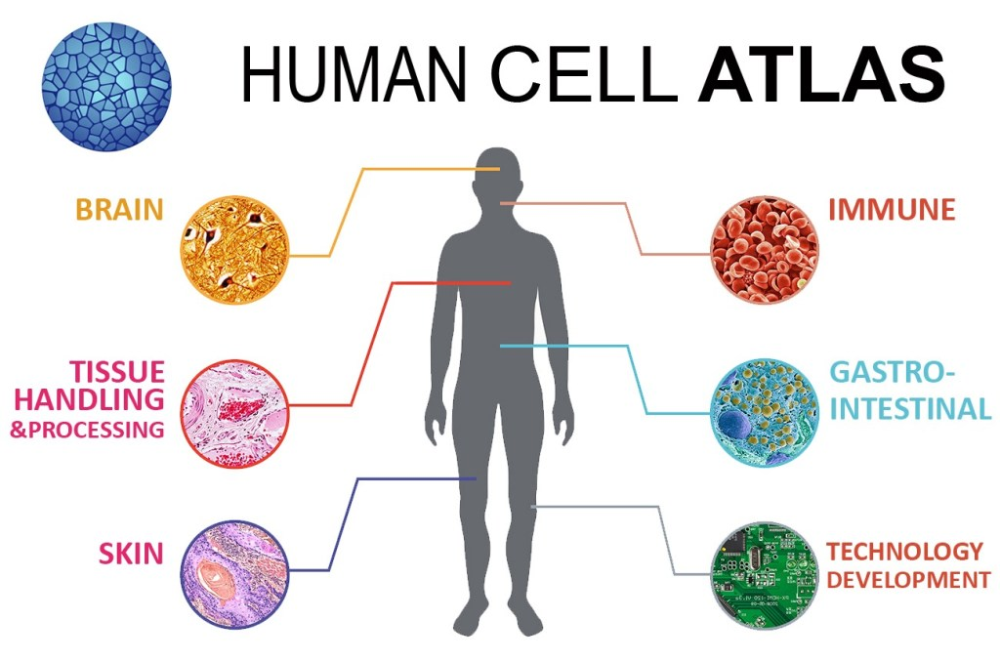
Applications (in vitro, ex vivo, and in vivo)
We can apply the system for a variety of cell types understand the relationship between bio-electric-mechano-physiological behaviors and functionality:
Cancer Cells:
Tumorigenesis
Self Integration
Migration
Neurons:
Brain signal variations
Understanding Neural Networks
Implications for neurological diseases
Credit: Chan Zuckerberg Initiative

Slide 10
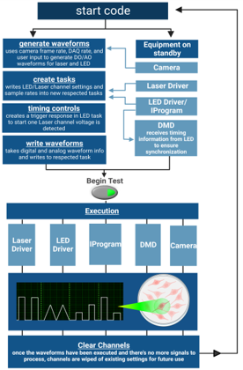
Labview Interactive System
Why is it important?
Customized automatic operation
Centralizes controls
Synchronization
Flexible signal creation/acquisition
Waveform types:
Square
Triangle
Arbitrary
Optopatch
Sinusoidal

Slide 11
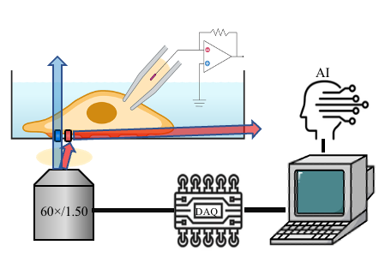
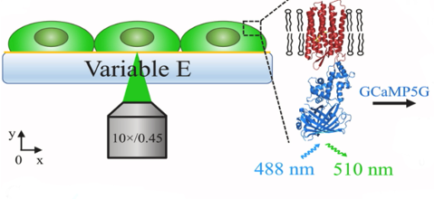
Experimental Design
GCaMP5G: genetically encoded calcium indicator with blue excitation and green emission
Can fluorescently visualize and collect data on calcium signaling in HCT-8 cells
Information from computer interface sent out to DAQ Card, then communicating to respective hardware. This leads to final execution of red and blue light reaching the sample as well as membrane potential measurements by patch clamp.

Slide 12
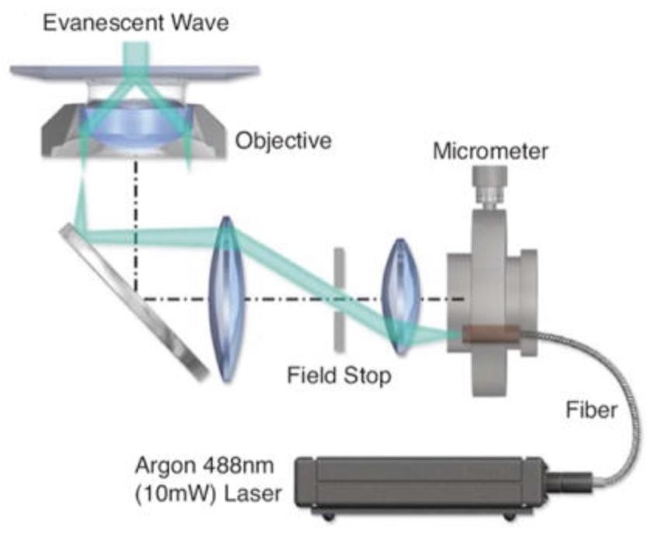
Microscopy Set-Ups: TIRF (in vitro and ex vivo)
Total
Internal
Reflection
Fluorescence
The total internal reflection of light at the glass-liquid boundary creates an evanescent wave. These waves have a notoriously rapid exponential decay, allowing us to accurately image fluorescent molecules within direct vicinity without interference
(Fish, 2018)​

Slide 13
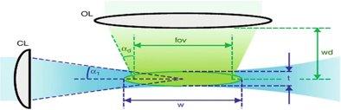
Microscopy Set-Ups: SPIM (in vivo and ex vivo)
Selective
Plane
Illumination
Microscopy
Able to acquire 3D fluorescence images by focusing laser light into a thin sheet and collecting a stack of 2 D images
(Lavagnino et al., 2013)

Slide 14
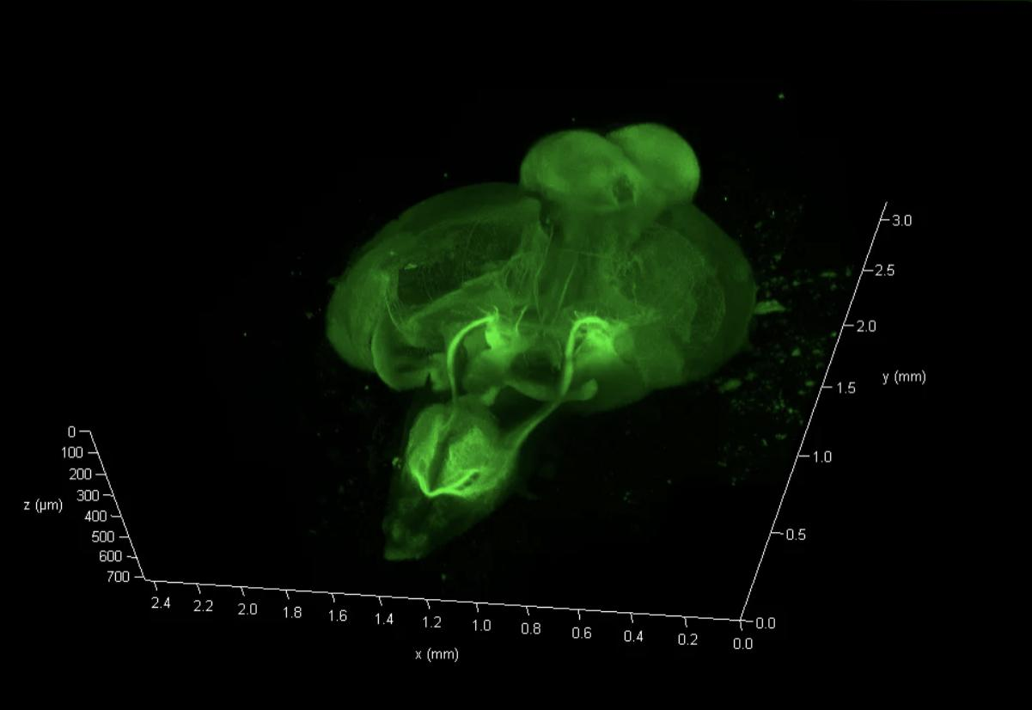
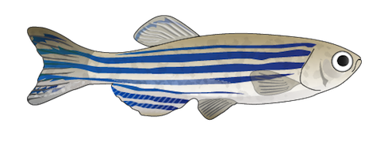
On-going Work
By expanding the system to 3D we will be able to study in the vault zebrafish brain to determine brain signal variations in response to visual stimuli.

Slide 15
References
Chenyu Liang, Qian Zhang, Xin Chen, Jiawei Liu, Mai Tanaka, Shu Wang, Sharon E. Lepler, Zeyuan Jin, Dietmar W. Siemann, Bo Zeng, Xin Tang, Human cancer cells generate spontaneous calcium transients and intercellular waves that modulate tumor growth, Biomaterials, Volume 290, 2022, 121823, ISSN 0142-9612, https://doi.org/10.1016/j.biomaterials.2022.121823.
Werley, C. A., Brookings, T., Upadhyay, H., Williams, L. A., McManus, O. B., & Dempsey, G. T. (2017, September 11). All-optical electrophysiology for disease modeling and pharmacologicalf characterization of neurons. Current protocols in pharmacology. Retrieved October 3, 2022, from https://www.ncbi.nlm.nih.gov/pmc/articles/PMC5721518
Fish, K. N. (2009, October). Total internal reflection fluorescence (TIRF) microscopy. Current protocols in cytometry. Retrieved October 3, 2022, from https://www.ncbi.nlm.nih.gov/pmc/articles/PMC4540339
Lavagnino, Z., Zanacchi, F.C., Diaspro, A. (2013). Selective Plane Illumination Microscopy (SPIM). In: Roberts, G.C.K. (eds) Encyclopedia of Biophysics. Springer, Berlin, Heidelberg. https://doi.org/10.1007/978-3-642-16712-6_830

Slide 16
Thank You!

Slide 17
Our Team
Dr. Xin Tang
(xin.tang@ufl.edu)
Chenyu Liang
Miao Huang
Abygale Cochrane
Erica Hengartner

